Slide 1
Innovation in Healthcare
Some live examples..
March 2016

Slide 2
What's the problem with innovation..

Slide 3
What's the problem with innovation..
1. Its uncomfortable.. Its change..
People like what they know and are used to..
FEAR..

Slide 4
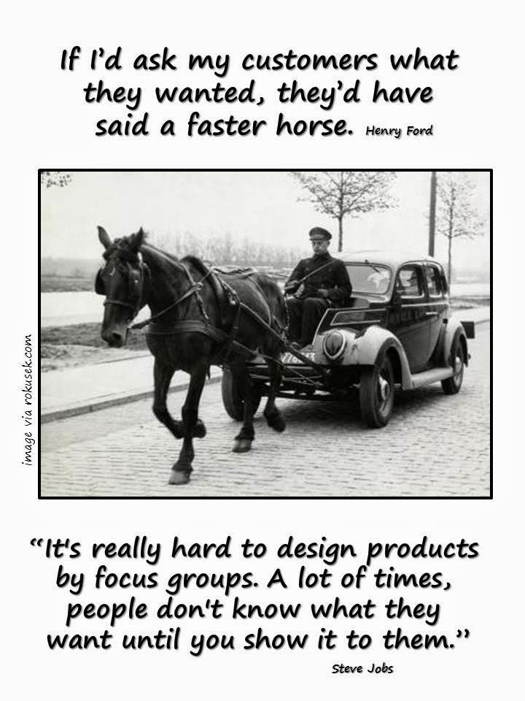

Slide 5
What's the problem with innovation..
1. Its uncomfortable.. Its change..
People like what they know and are used to.. So they are afraid!
2. It can go wrong..
No blame culture is very important
BUT
Do your homework
A lot of work and research is needed to ensure correct direction

Slide 6
Why innovation in healthcare..
Innovation for the sake of innovation..
Is innovation just technology?

Slide 7
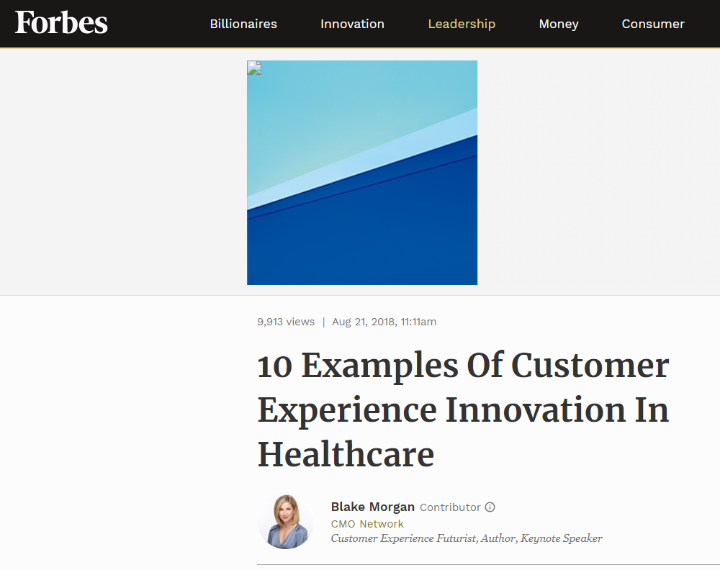
Forbes top 10 list of healthcare innovations
1. Virtual Reality
2. Artificial Intelligence
3. Internet of Things
4. Big Data
5. Lighting Control Systems
6. Individual Temperature Controls
7. Virtual Networks
8. Telemedicine
9. Chatbots
10. Employee Feedback

Slide 8
Why innovation in healthcare..
Innovation for the sake of innovation..
Is innovation just technology?
Innovation is a way of life.. Every day, every step, every process think.. How can I make it better, cheaper, more convenient..
You can innovate as a regulator, as a payer, as a provider, even as a person..

Slide 9
Why innovation in healthcare..
Innovation for the sake of innovation..
Is innovation just technology?
Innovation is a way of life.. Every day, every step, every process think.. How can I make it better, cheaper, more convenient..
You can innovate as a regulator, as a payer, as a provider, even as a person..
It has to:
Reduce cost, improve outcome, improve customer experience..
It has to make life better
Its NOT to JUST buy a fancy technology

Slide 10


Dubai, a permission to innovate..

Slide 11
Overview..
Dubai Health financing system design..
Innovation & technology in health care in Dubai is used for the following areas:
  Insurance system design
  Manage the system & Improve outcomes of quality of care
    Eclaim link
    Ejada
  Increase efficiency and value for money spent
    E referral
    E prescriptions
    Trends and health analytics
  Improve customer experience and access to care

Slide 12


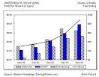







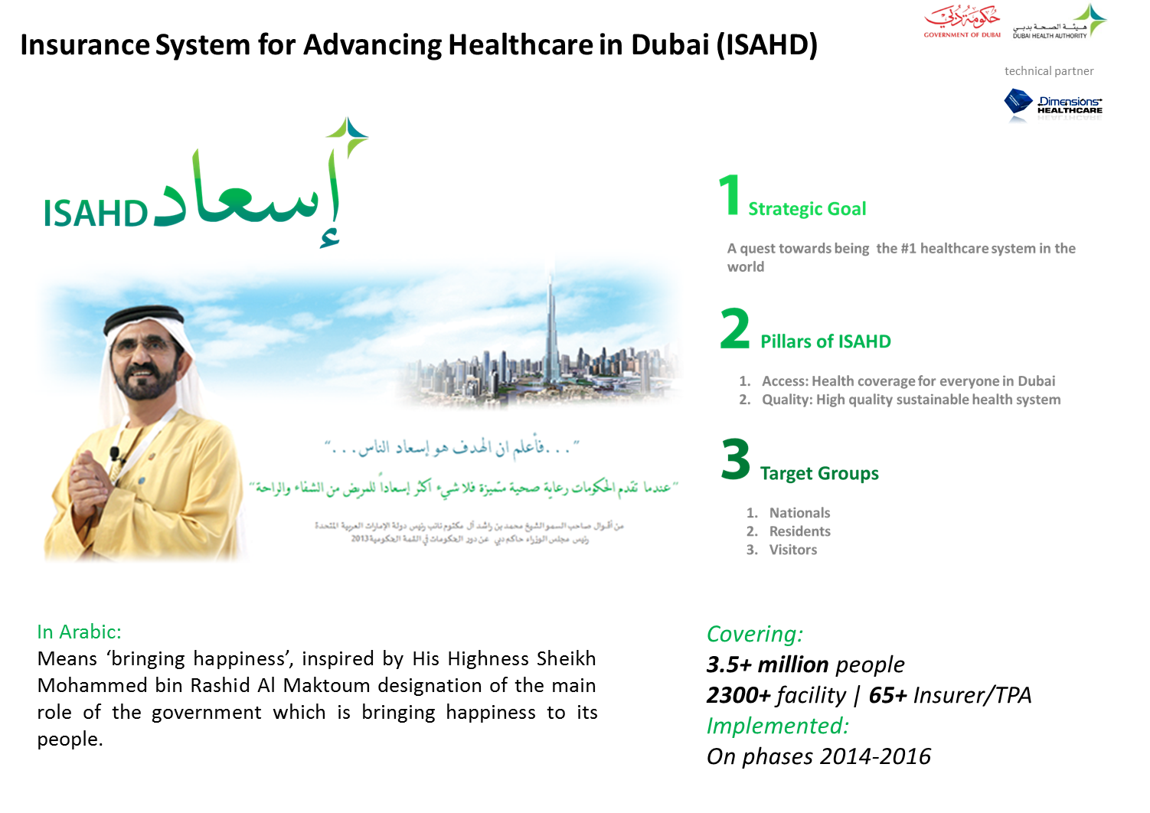
Dubai system design
الحكومة: الزامية الضمان الصحي في الامارة
Government: Mandate Health Insurance
الهيئة: تطبيق ورقابة الضمان الصحي
DHA: Implementation & Regulation
مقدمي الخدمات في القطاع الحكومي:
تقديم الخدمات للجميع والحصول على مقابل هذه الخدمات من البرامج التأمينية
Public Providers
مقدمي الخدمات في القطاع الخاص:
تقديم الخدمات للجميع والحصول على مقابل هذه الخدمات من البرامج التأمينية
Private Providers
التغطية:
برامج الضمان الحكومية
شركات الضمان
Coverage
التمويل:
الحكومة
اصحاب العمل
الكفلاء
Funding
الزائرون
Visitors
المقيمون
Residents
المواطنون
Nationals
السعادة والاطمئنان
الوصول للخدمات الصحية
Access
تنظيم ورقابة المنظومة
Regulation
جودة عالية للخدمات الصحية
Quality
تنمية مستدامة
Sustainability
12

Slide 13
Overview..
Dubai Health financing system design..
Innovation & technology in health insurance in Dubai mandate:
  Manage the system & Improve outcomes of quality of care
    Eclaim link
    Ejada
  Increase efficiency and value for money spent
    E referral
    E prescriptions
    Trends and health analytics
  Improve customer experience and access to care

Slide 14
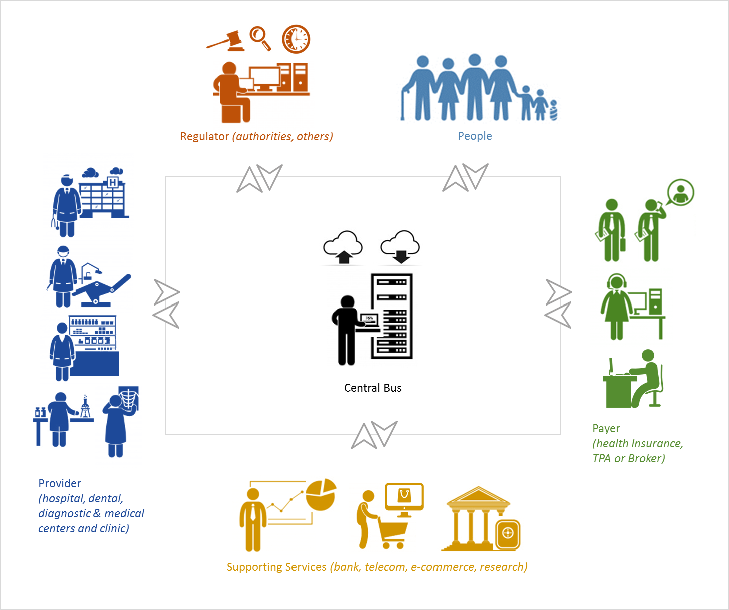
transactions on
eClaimLink
Claims Gross (Billion AED)
Electronically captured through eClaimLink
Interfaces, web services
Dashboards & Direct Access
Communication
Apps & Interfaces
Claim Submission
Prior Request
eRx Request
eReferral
Remittance Advice
Prior Authorization
Erx Authorization
Person Register
Support Transactions
0.5 million
claim per month
2.5 million
claim per month

Slide 15
Ejada.. Diabetes case
Dubai Diabetes registry.. 2015, June cut, 2.4 M members
460,000 people tested for Diabetes
213,000 patients so far.. Representing 8% of the insured population.. How many undiagnosed???
Project of registering outcomes started 3 months ago..
60% of the population with HbA1C < 7
40% HbA1C > 7 10% > 9.5
Cost of uncontrolled is 25x the cost of controlled patient
Last year we spent: AED 732 Million on diabetic care
Policy outcome: include screening in EBP
HbA1C > 9.5
HbA1C < 7

Slide 16
Overview..
Dubai Health financing system design..
Innovation & technology in health care in dubai is used for the following areas:
  Manage the system & Improve outcomes of quality of care
    Eclaim link
    Ejada
  Increase efficiency and value for money spent
    E referral
    E prescriptions
    Trends and health analytics
  Improve customer experience and access to care

Slide 17


e-Referral.. Solution of Dubai
The referral number is given to the patient
A referral number is requested
and generated from DHA hub
3
General Practitioner
2
After diagnosis, GP decides that a referral is required
1
Patient
Specialist deliver service if e-referral confirmed
6
5
DHA Hub
4
Specialist confirm e-referral from DHA hub
The referral number
Is submitted to the specialist or reception
Specialist or
Consultant
Can forward same referral or generate a new one as needed to another specialist
e-Referral Solution

Slide 18
Overview..
Dubai Health financing system design..
Innovation & technology in health care in dubai is used for the following areas:
  Manage the system & Improve outcomes of quality of care
    Eclaim link
    Ejada
  Increase efficiency and value for money spent
    E referral
    E prescriptions
    Trends and health analytics
    Improve customer experience and access to care

Slide 19


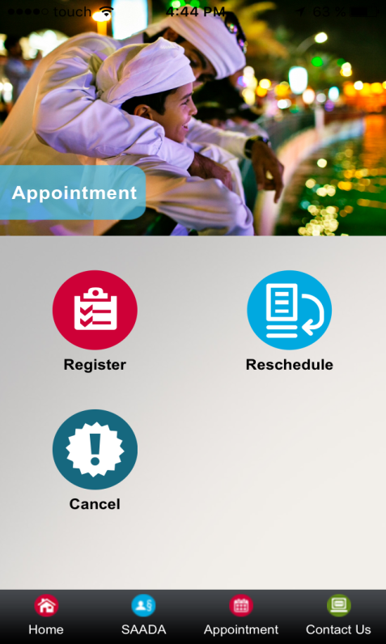
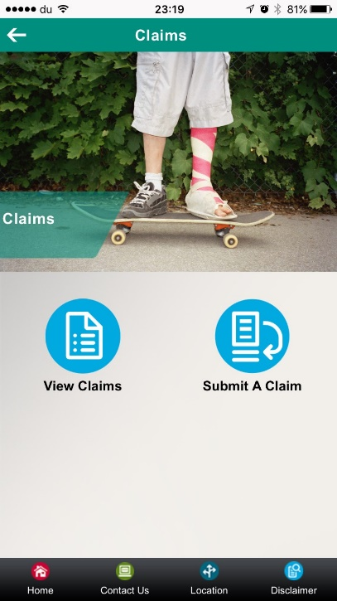
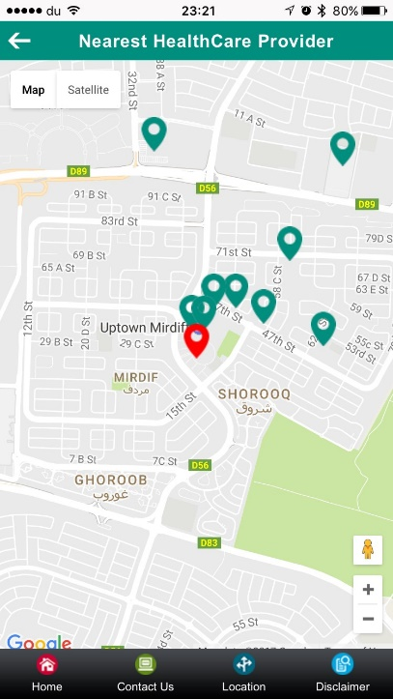
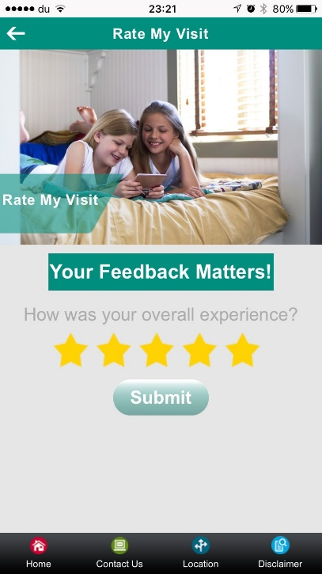
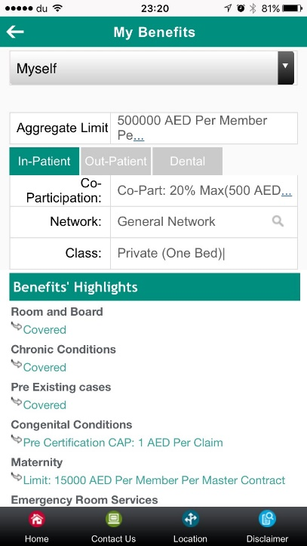

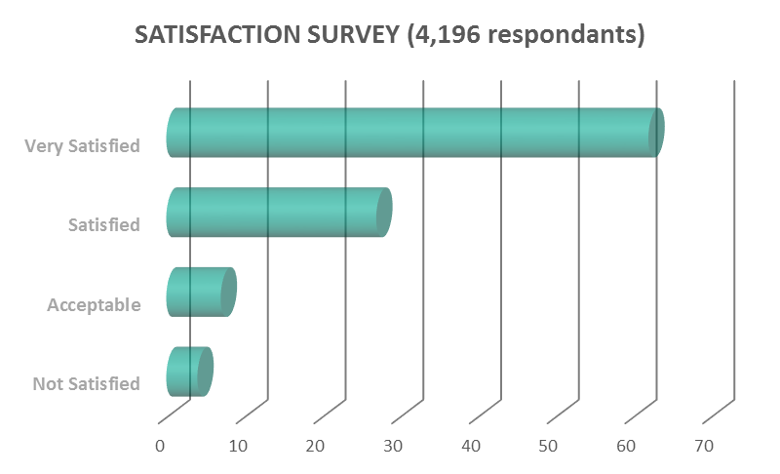
التطبيق الذكي
برنامج الضمان الصحي للمواطنين في دبي
معلومات عامة
حجز المواعيد
اصبح برنامج «سعاده» المعيار الذي تقاس به برامج التأمين الصحي في المنطقة
يعمل البرنامج بطريقة (Population Management) حيث تصمم المنافع حسب احتياجات أفراد المجتمع ويجري تطويرها بشكل دوري مستمر حسب هذه المتطلبات
يغطي البرنامج نسبة عالية من احتياجات المواطنين في الامارة خاصة من زيارات الاخصائيين والعمليات الجراحية مما ادى الى تقليل أوقات الانتظار لهذه الخدمات بشكل كبير اضافة الى مجموعة متنوعة من الخدمات غير المتوفرة في القطاع الحكومي مما ادى الي نشر السعادة والرضا بين المستفيدين
معاينة المطالبات
معاينة المنافع
تحديد مزودي الخدمة
تقييم زيارة المراكز الصحية

Slide 20
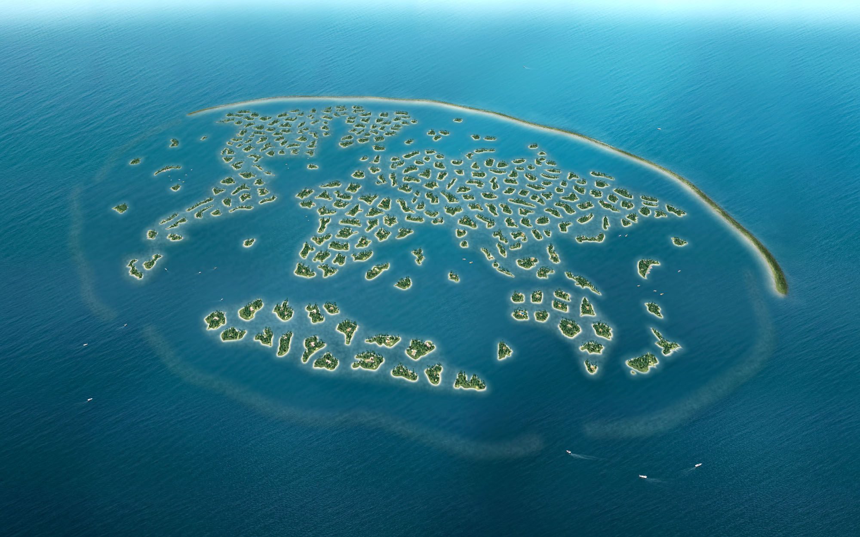
Thank you.

Slide 21
Further to my previous email, in order to give you further insight, please note that the following key points will come out of the panel discussion:
Innovation in Health is shaped by Healthcare trends
In mature countries there are increased needs (e.g. chronic diseases, longevity) and less financing from social welfare
In emerging countries the need is access to healthcare and building new systems and infrastructures to reach people
The role of digital health, wearables
Preventative healthcare as a cost effective and convenient solution
Increased access to healthcare and self servicing
Transition from just healthcare insurance to healthcare services

Slide 22
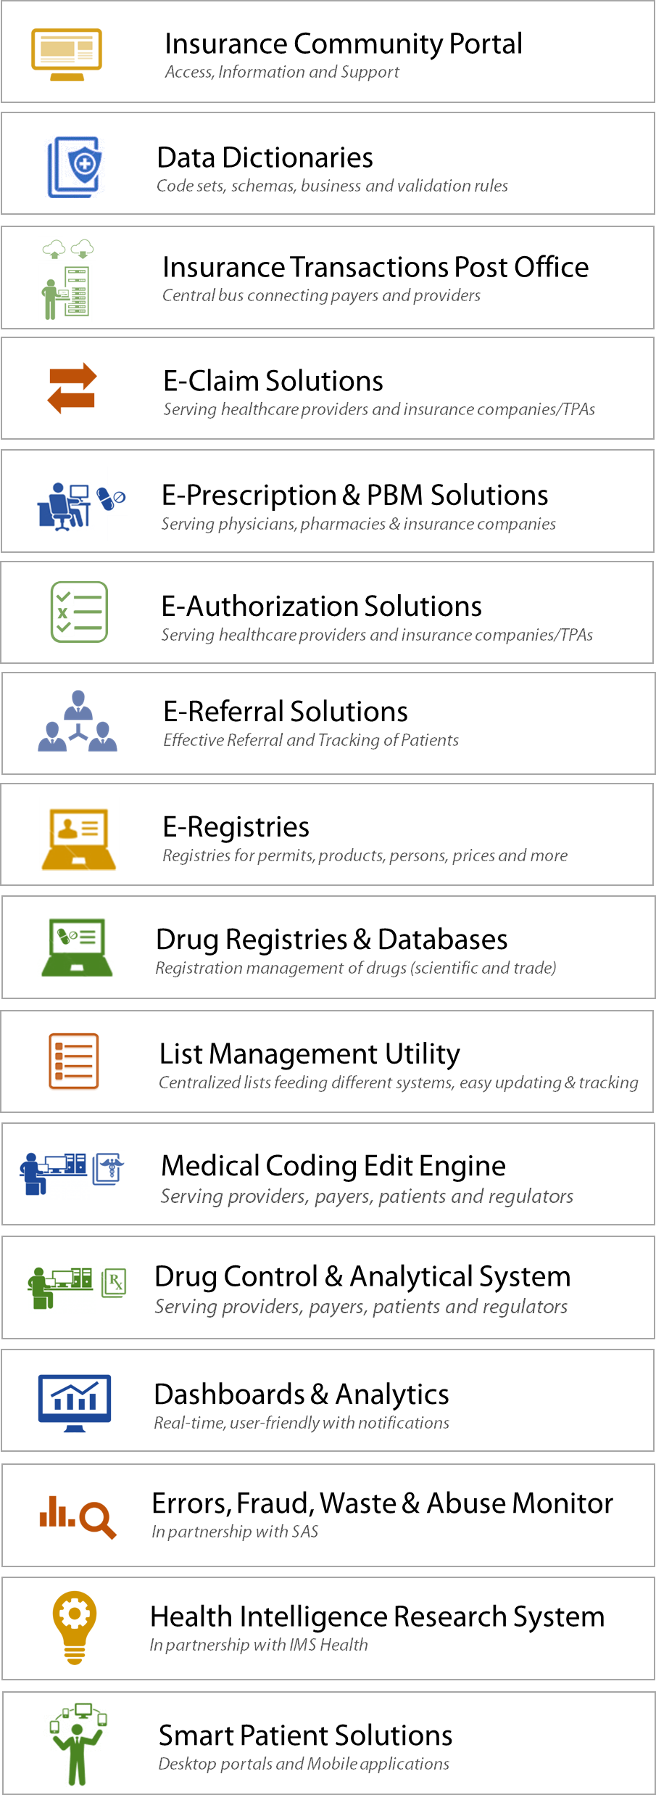
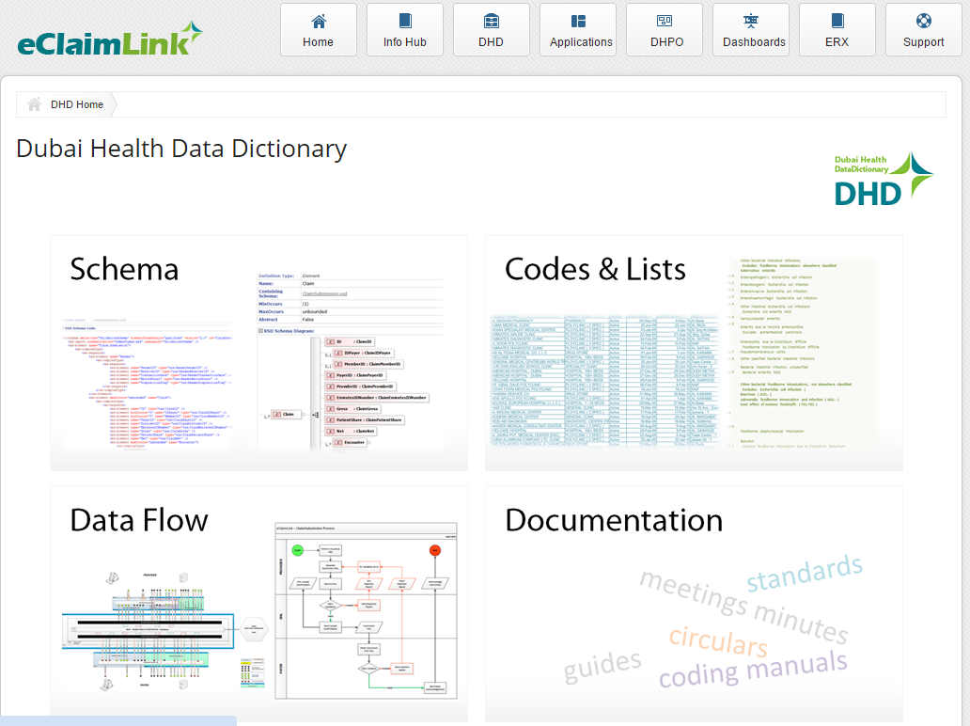
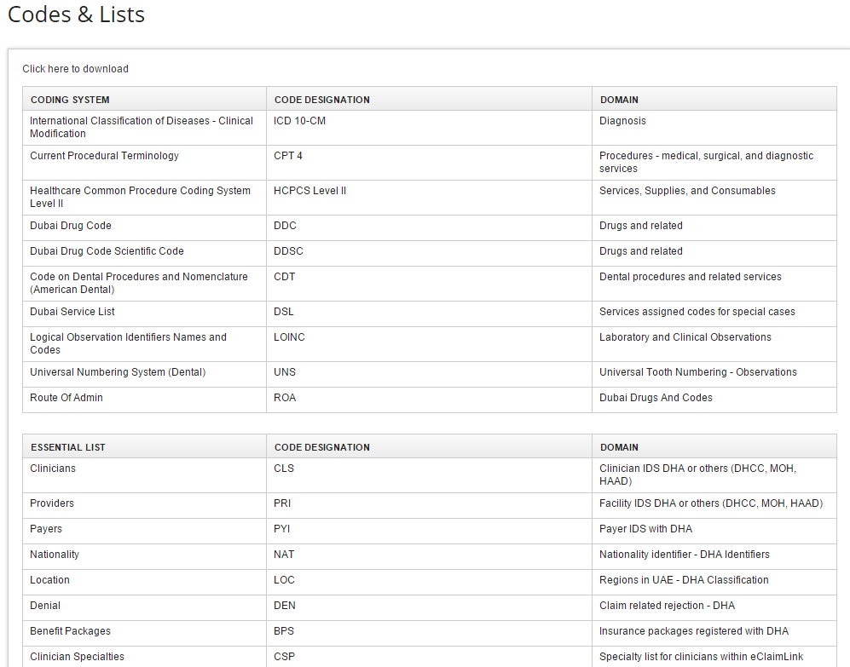
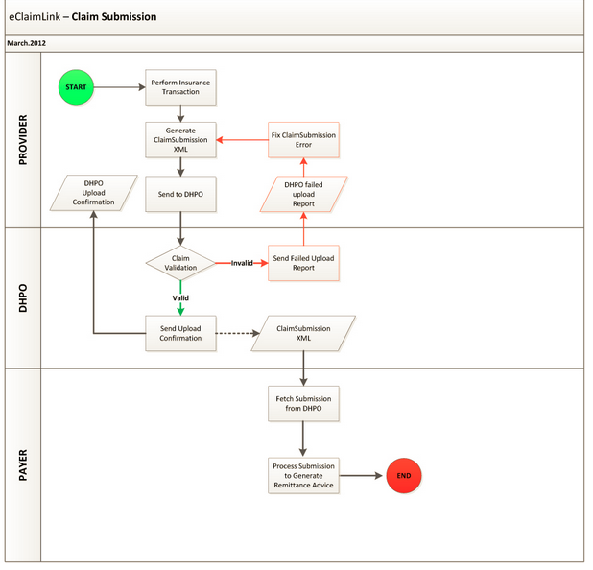
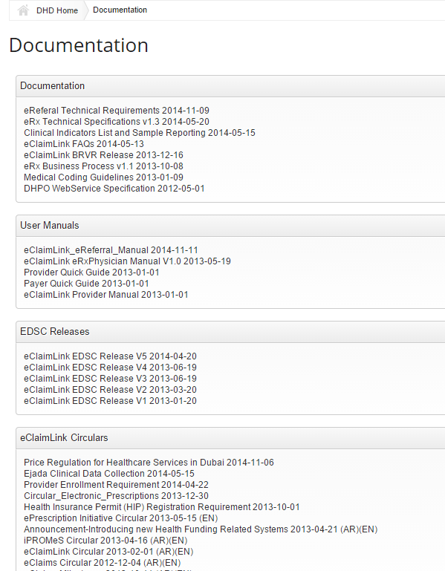
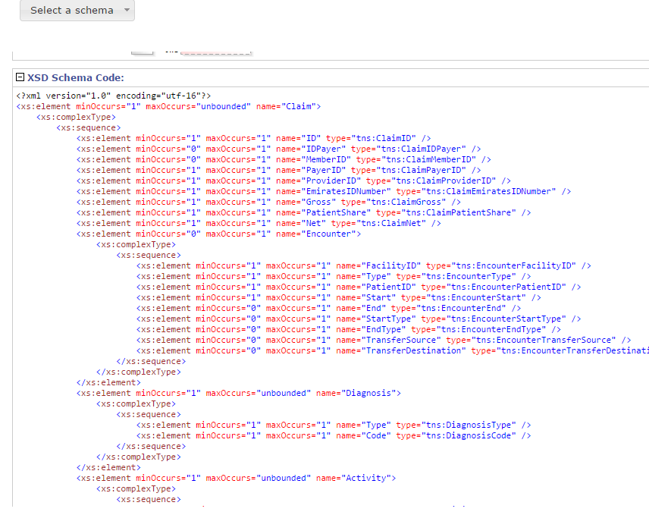
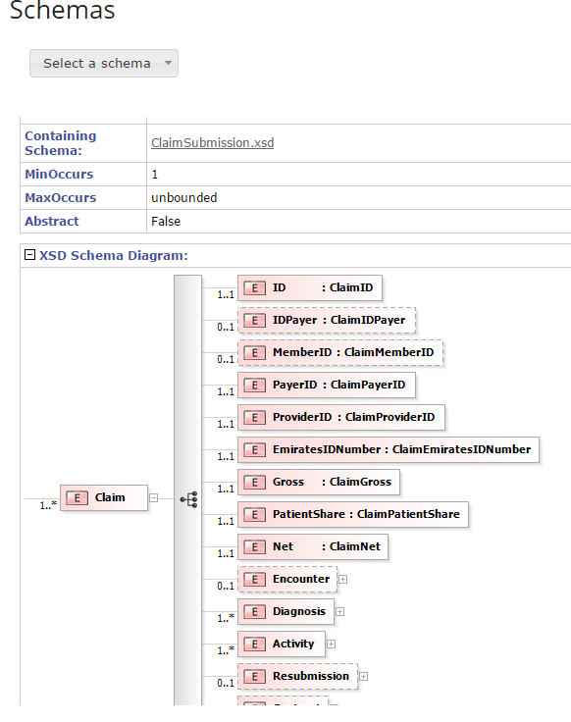
Data Dictionaries
Standard Health Language (lists and codes)
Standard Communication Schema
Business & Validation Rules
Process and Data Flow
Documentation; Circulars, Manuals, Releases and Web Services

Slide 23
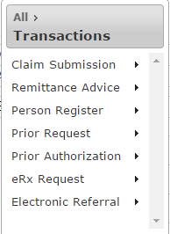
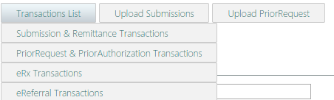
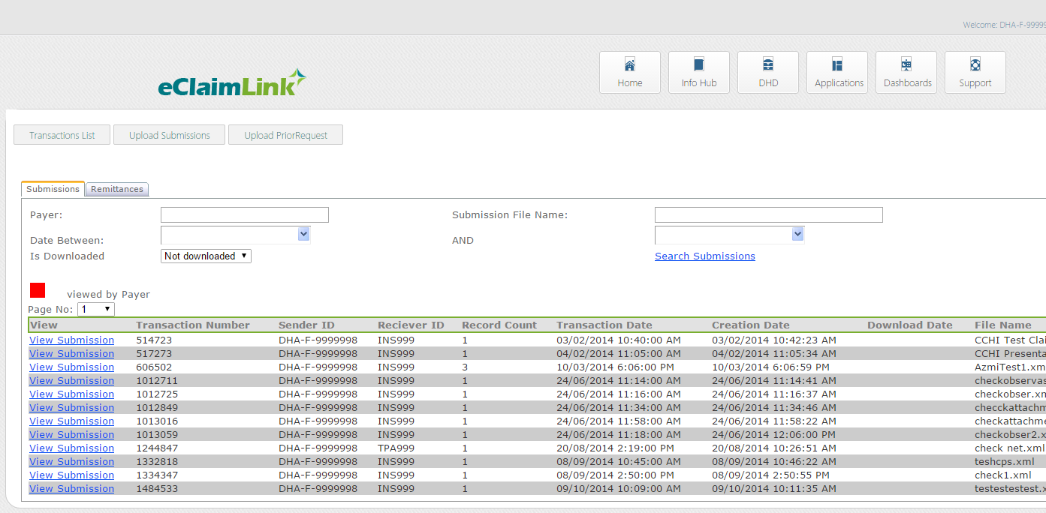
Insurance Transaction Post Office
The transaction post office bus for all payers and providers
Transactions based on web services (data uploads and downloads)
Interface to enable monitor and manage transaction uploads and downloads
Dubai Health Post Office (dhpo)

Slide 24
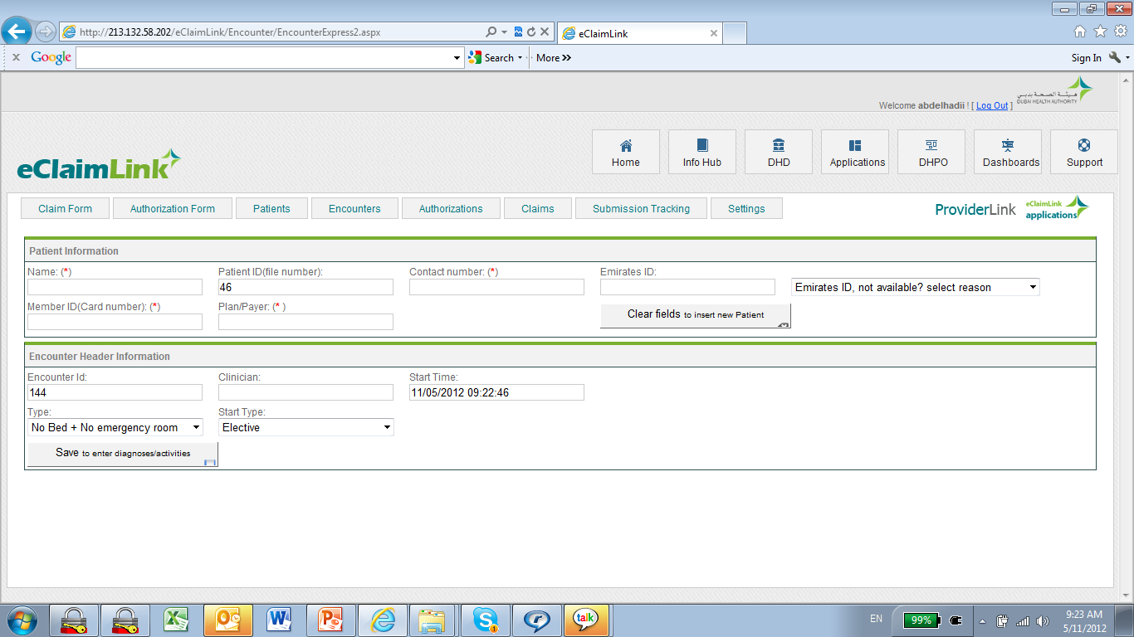
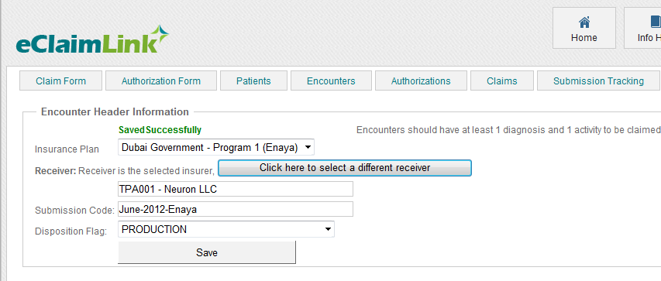
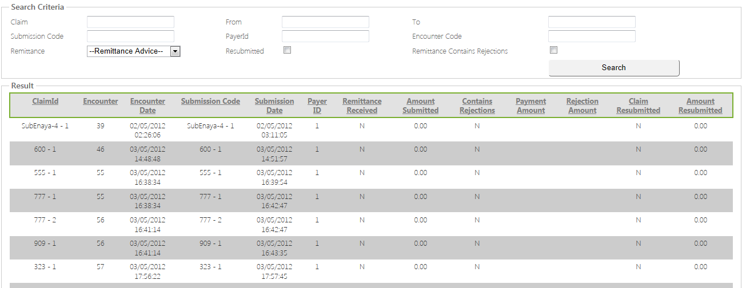
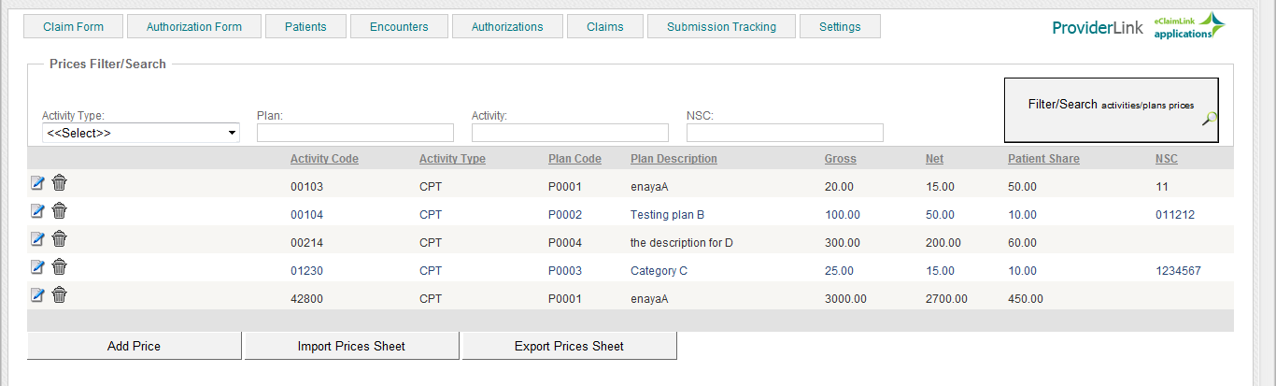
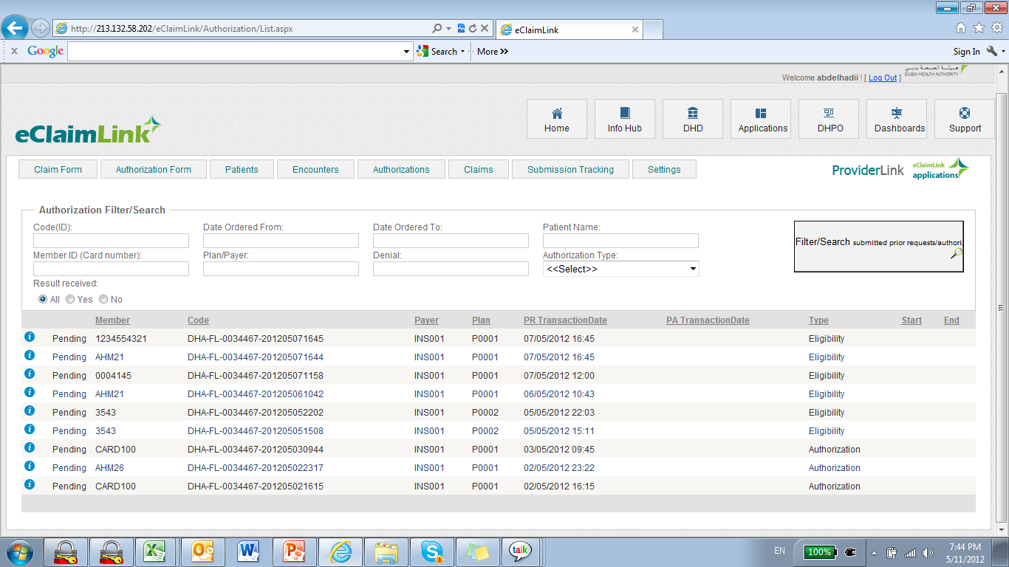
E-Claim Solutions (Provider)
Provider solution for claims generation & management
Patient/encounter management
Remittance advice parsing towards submissions
Submit / Receive transactions to/from post office
Note: Providers can integrated directly with post office from their hospital, clinic, pharmacy or lab management systems. This solution would be used mainly by early starting providers on the platform or providers who don’t have advanced IT capabilities.

Slide 25
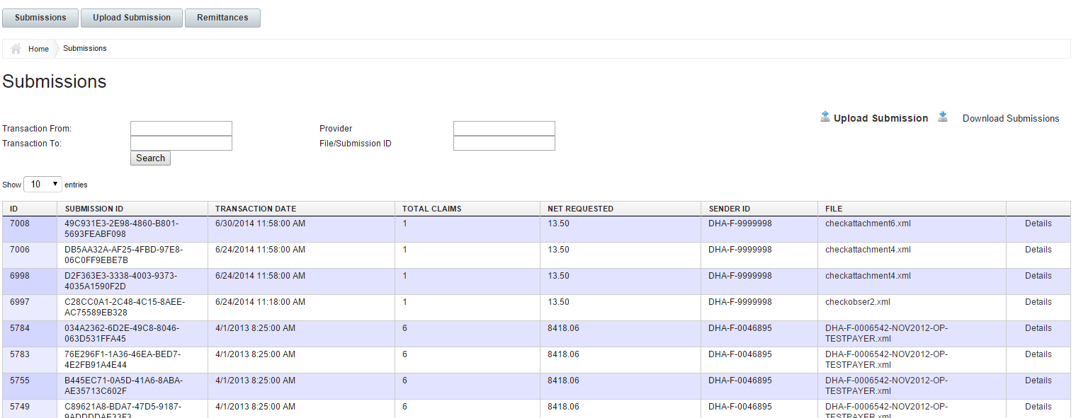
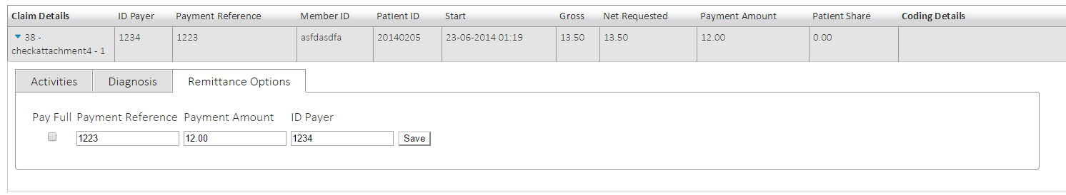
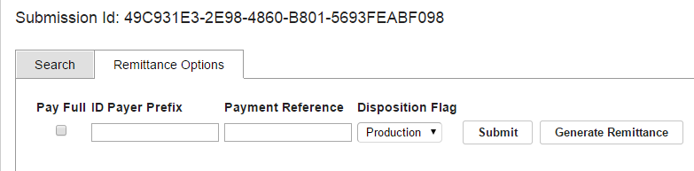
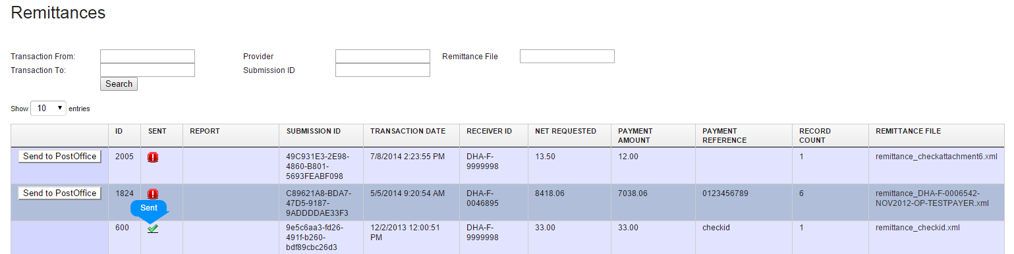
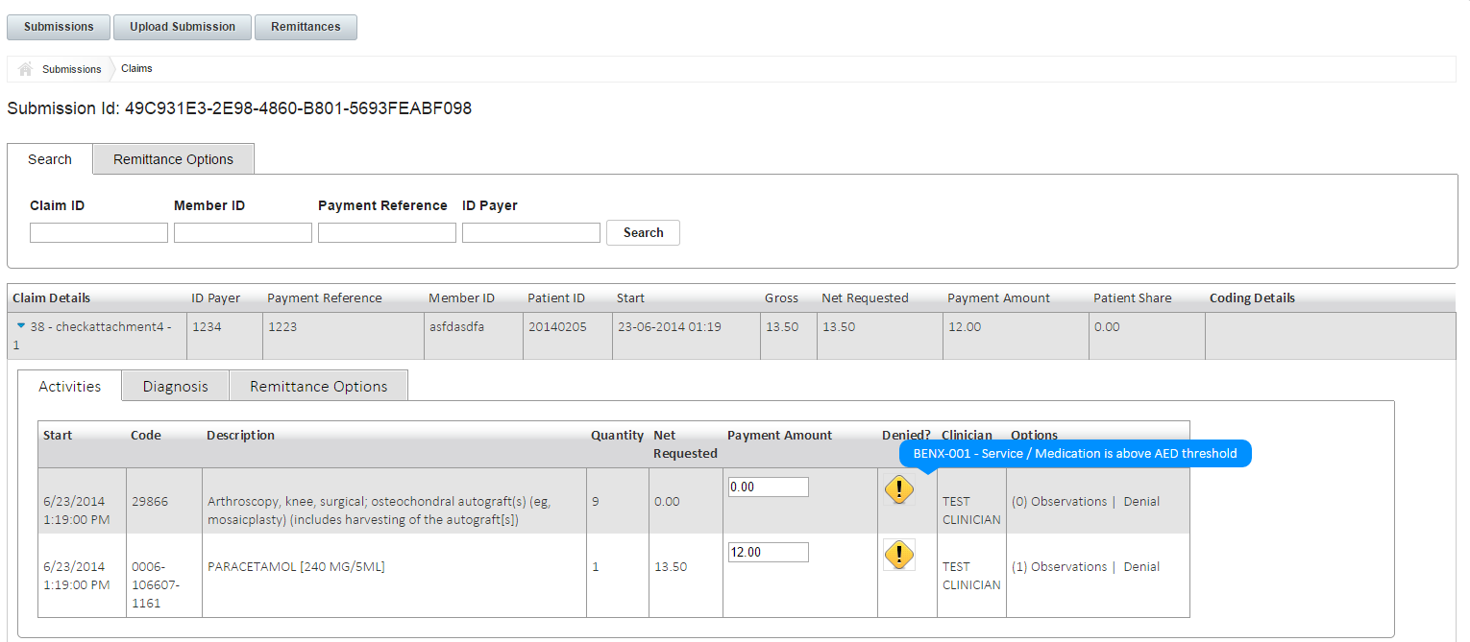
E-Claim Solutions (Payer)
Payer solution for claims receiving & parsing
Analysis of claims submitted
Validated towards sets of rules
Remittance advice generation
Submit / Receive transactions to/from post office
Note: Payers (Insurance and TPA) can integrated directly with post office from their insurance management systems. This solution would be used mainly by early starting payers on the platform or payers who don’t have advanced management systems.

Slide 26
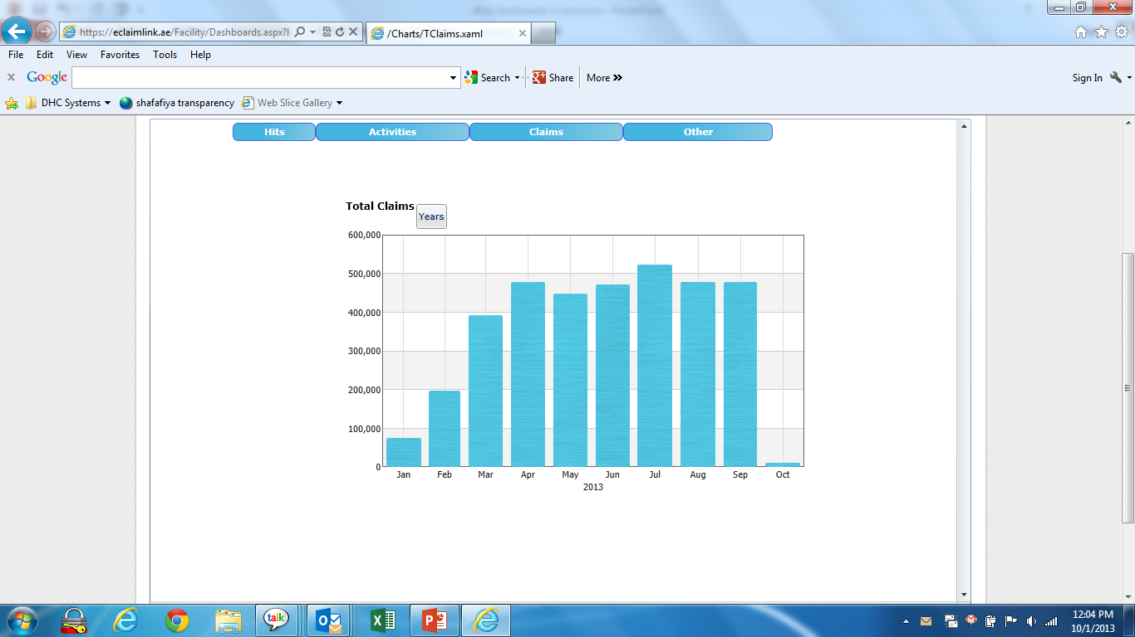
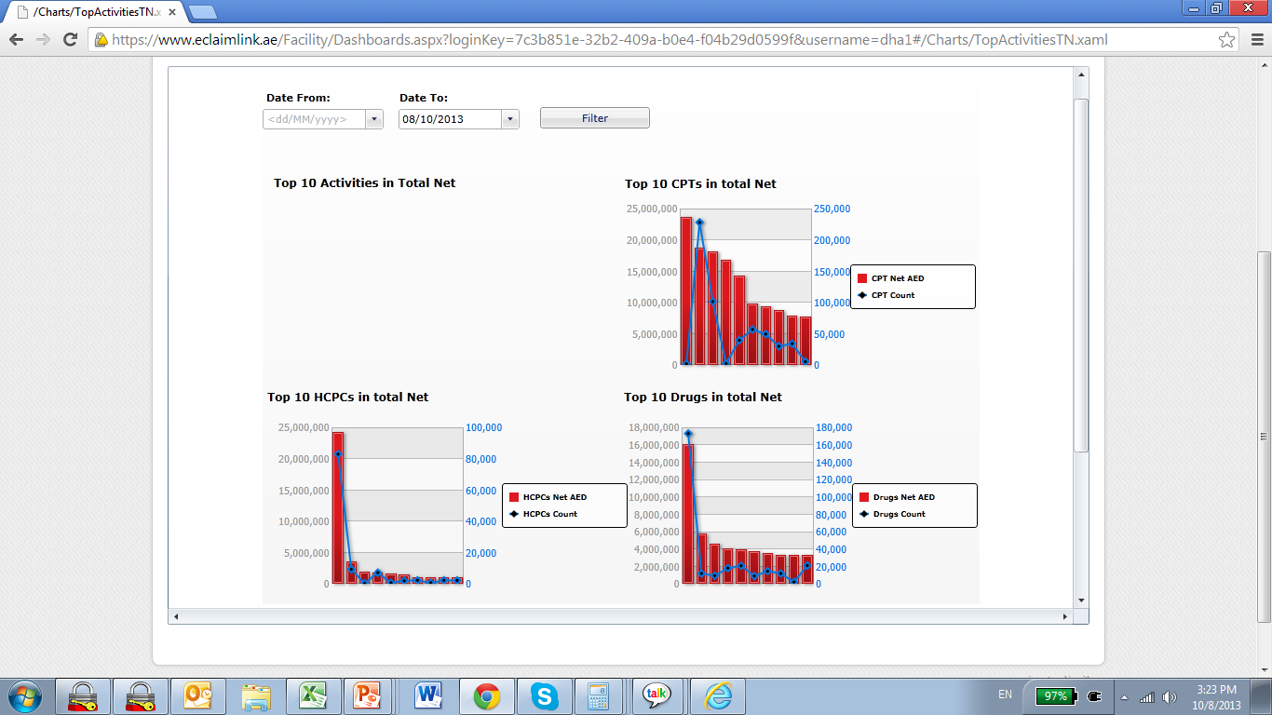

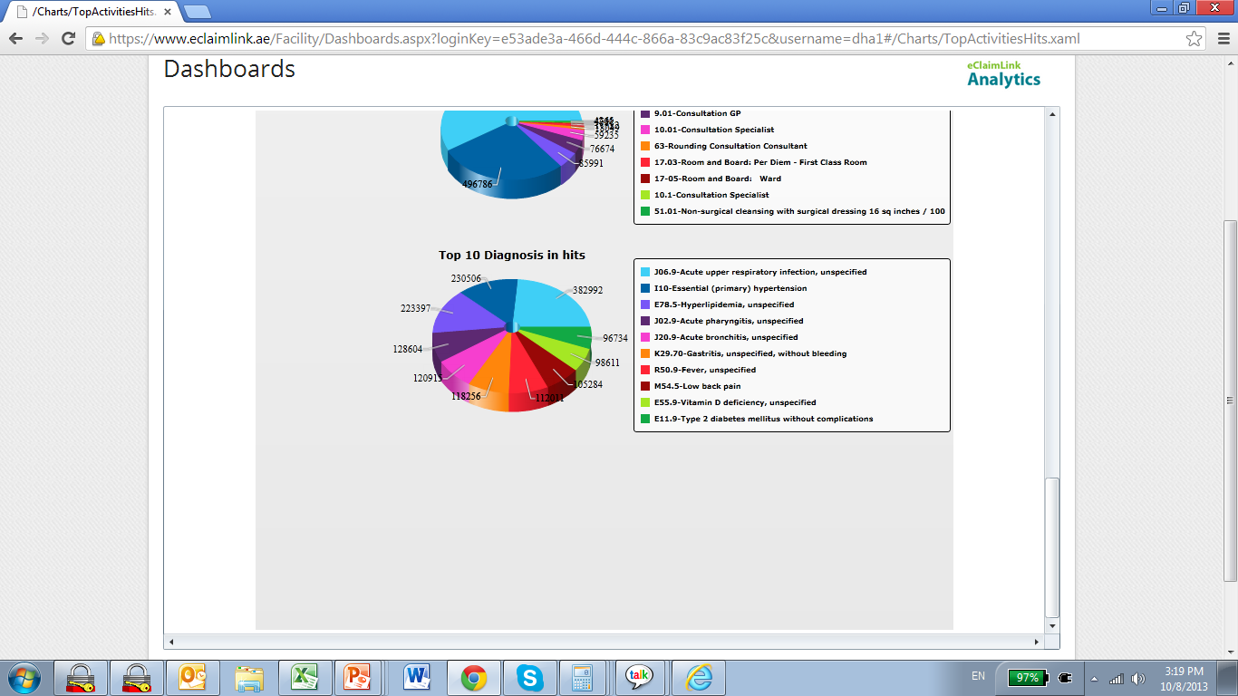
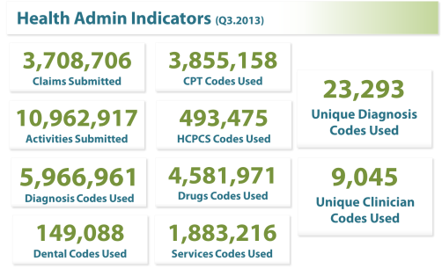
Ejada.. Outcome measurement
  Clinical outcomes
  Patient satisfaction outcomes
  Efficiency & financial performance

Slide 27
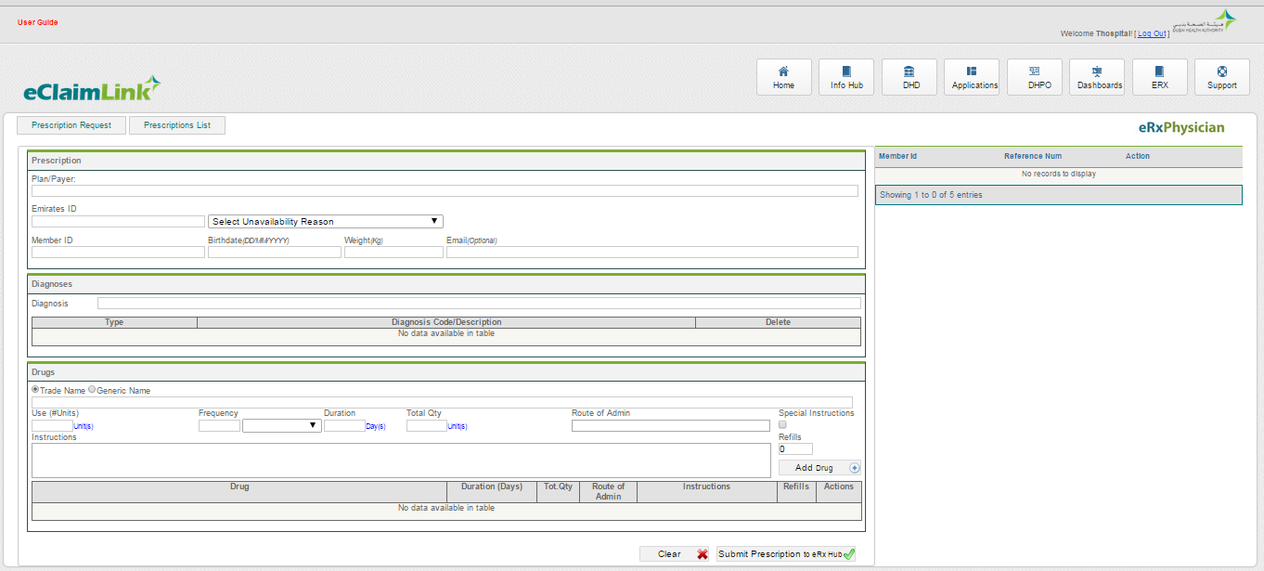
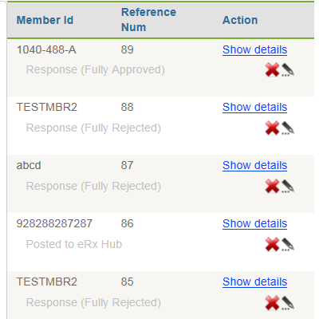
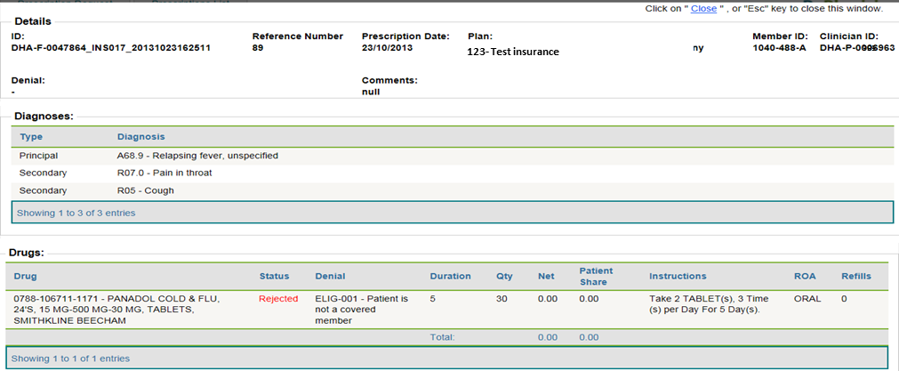
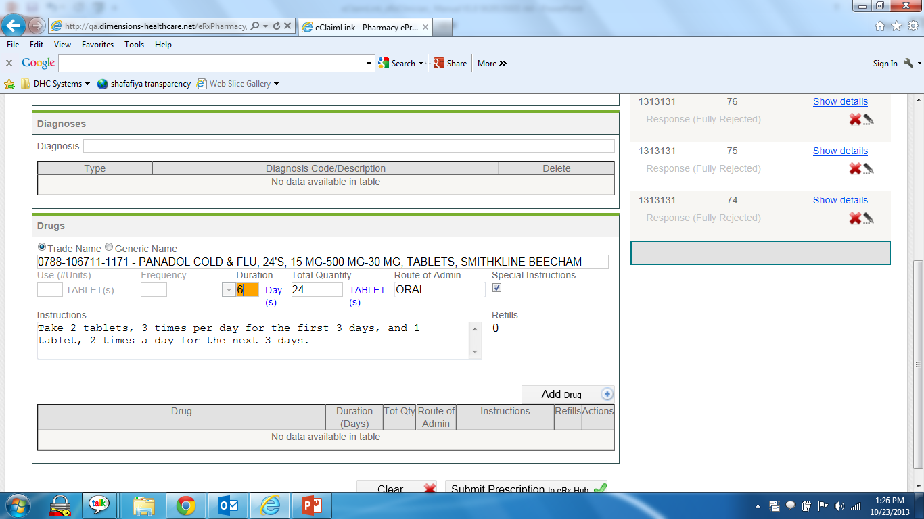
E-Prescription Solutions (Physician)
Fill and Generate e-prescriptions by physician
Dynamic filling of prescriptions information
Send e-prescriptions to eRx hub (post office)
Manage prescriptions posting and payer advisory response from payer
eRxPhysician

Slide 28
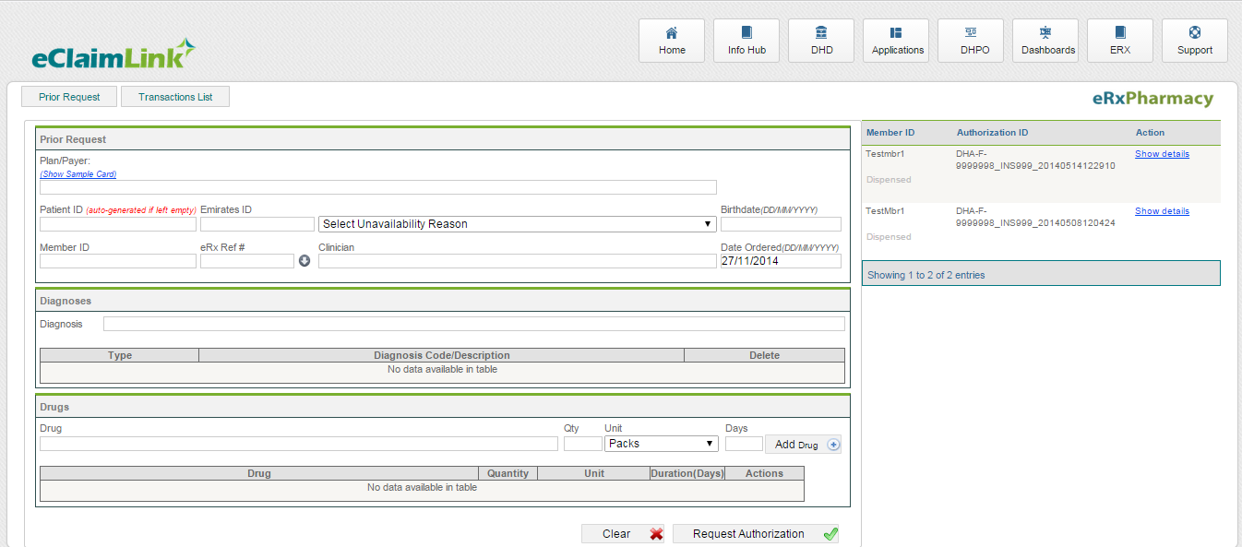
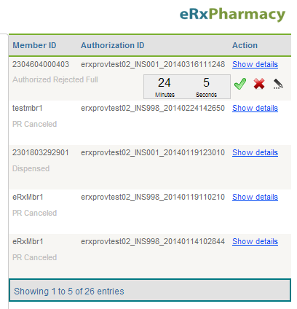
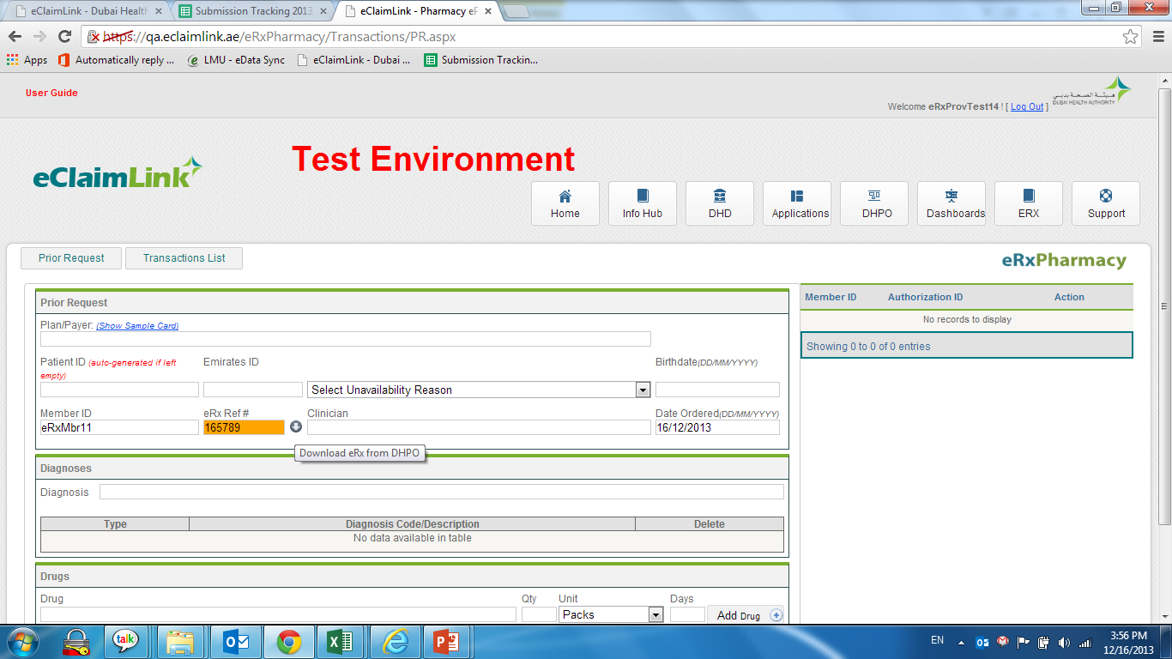
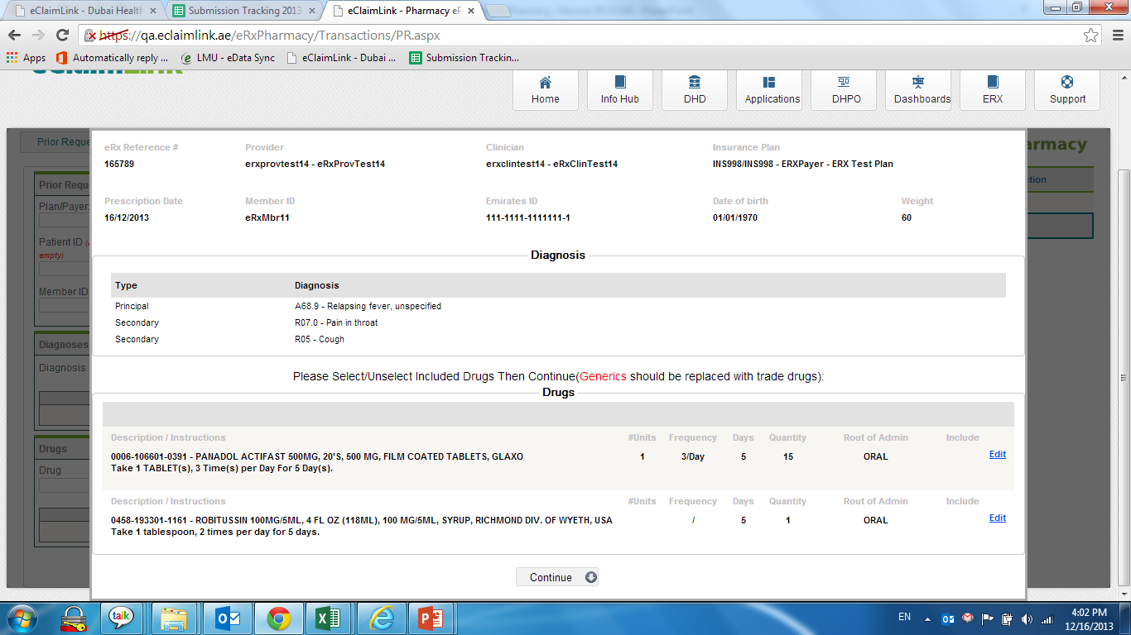
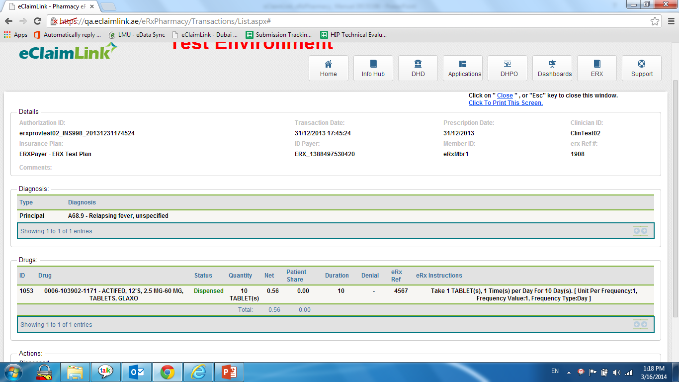
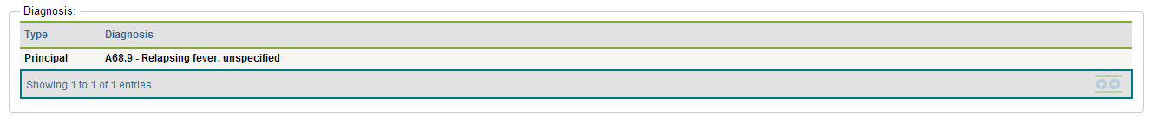
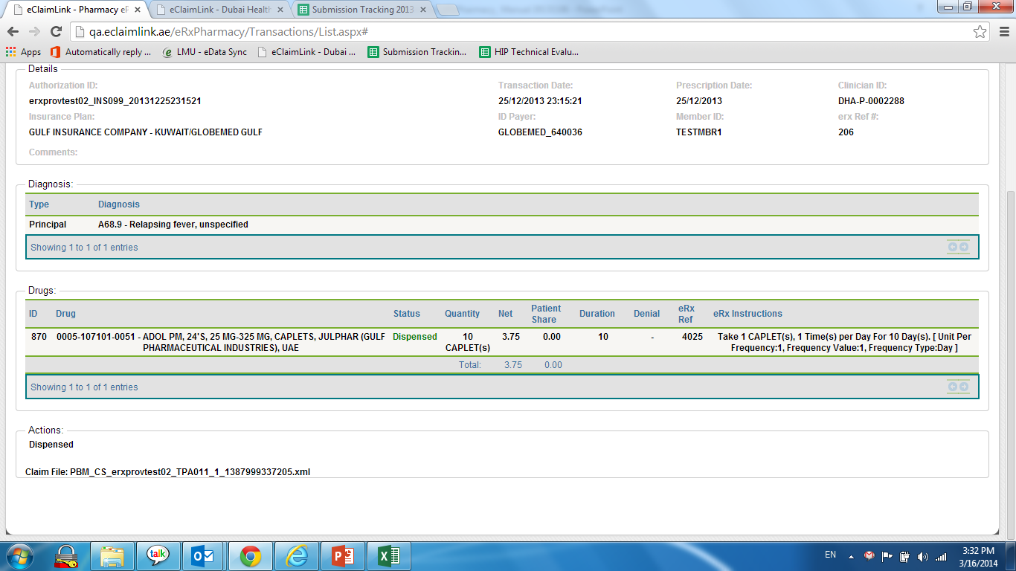
E-Prescription Solutions (Pharmacy)
Download e-prescriptions or fill prescriptions information
Generate and submit requests to payer
Receive and analyze authorization responses
Submit real-time claims for dispensed drugs
eRxPharmacy
PBMLink

Slide 29
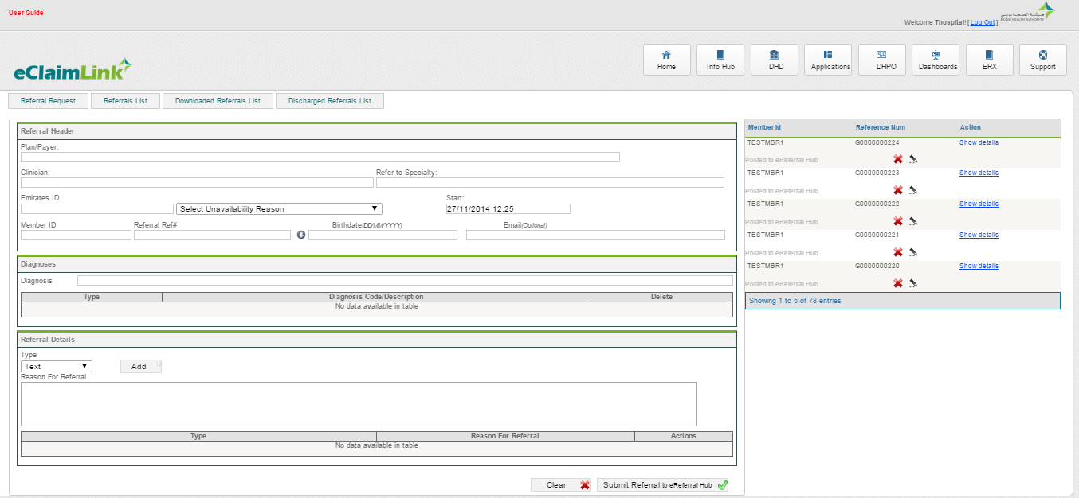
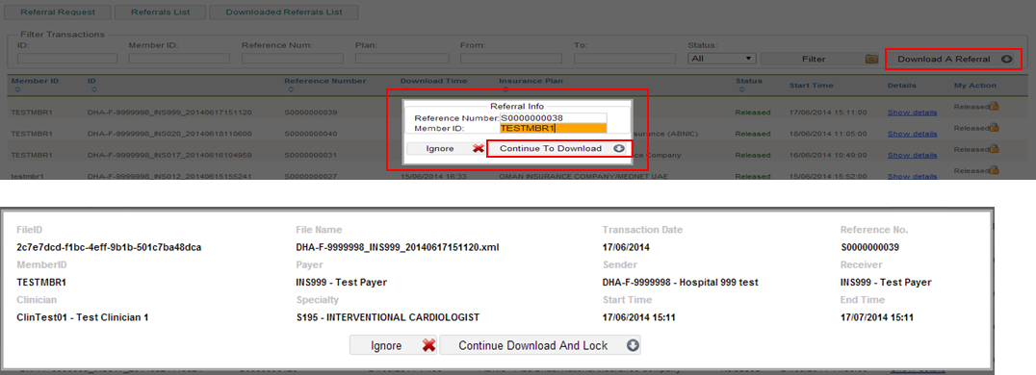
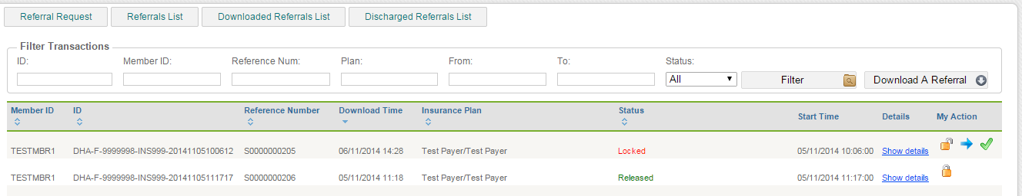



E-Referral Solutions
Fill and generate e-referrals for specialties
Validate and download referrals at facilities (locking it or releasing it)
Revision of cases by referring physician

